Slide 1
On the Ontological Modeling of Trees
David Carral¹, Pascal Hitzler², Hillmar Lapp³, and Sebastian Rudolph¹
¹ TU Dresden, Germany
² DaSe Laboratory, Wright State University, OH, USA
³ Center for Genomic and Computational Biology, Duke University, Durham, NC, USA

Slide 2
Trees

Slide 3
Trees

Slide 4
Trees
Ubiquitous structures in KR:
taxonomies,
meronomies,
decision trees,
branching processes,
...

Slide 5
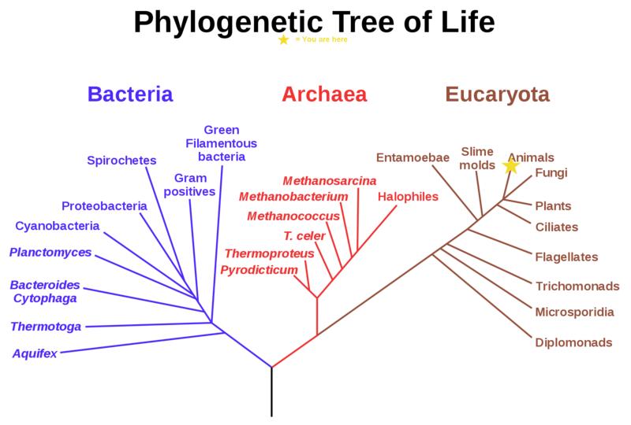
Motivation: Phylogenetic trees
Branching diagram or “tree” showing the inferred evolutionary relationships among various biological species or other entities based upon similarities and differences in their genetic characteristics.

Slide 6
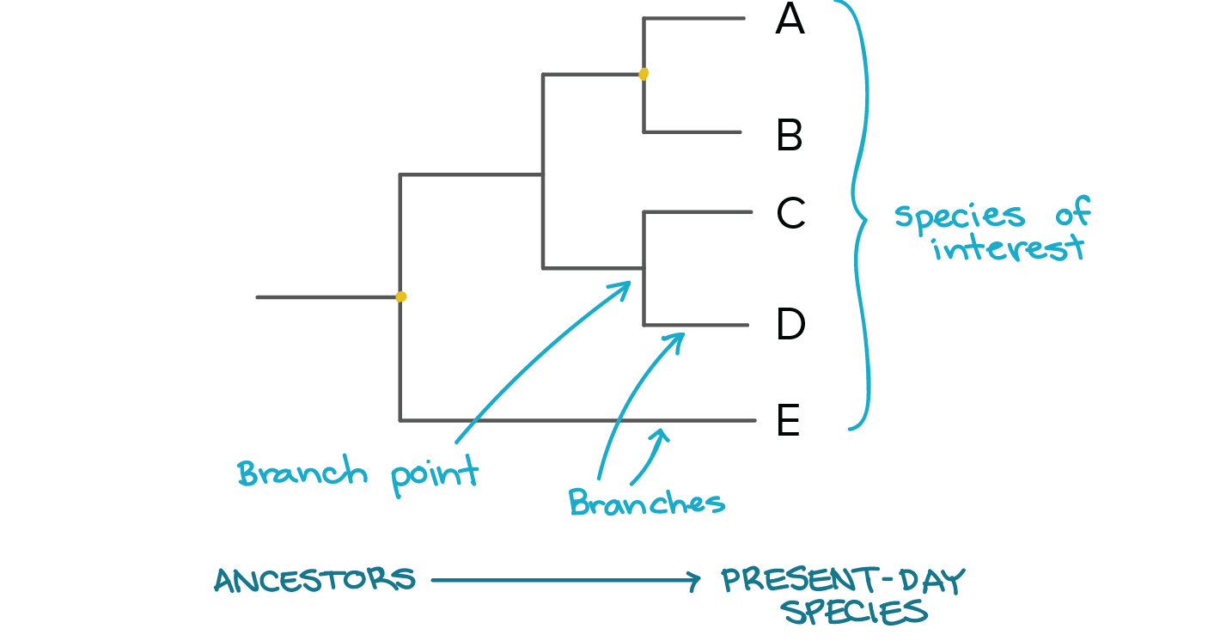
Competency questions
Finding the most recent common ancestor of a given number of nodes.
Enumerating the leaf nodes, or all nodes descending from a given node.
Enumerating the sequence of ancestors of a node to the root.
Identify the last ancestor of A which is not an ancestor of some other node E.

Slide 7
Rooted directed trees
A rooted directed tree (tree) is defined as a directed graph that satisfies all of the following properties:

Slide 8
Rooted directed trees
A rooted directed tree (tree) is defined as a directed graph that satisfies all of the following properties:
It contains exactly one root node, which has no incoming edges.

Slide 9
Rooted directed trees
A rooted directed tree (tree) is defined as a directed graph that satisfies all of the following properties:
It contains exactly one root node, which has no incoming edges.
Every node which is not the root has exactly one incoming edge.

Slide 10
Rooted directed trees
A rooted directed tree (tree) is defined as a directed graph that satisfies all of the following properties:
It contains exactly one root node, which has no incoming edges.
Every node which is not the root has exactly one incoming edge.
Every node can be reached from the root.

Slide 11
Limitations Regarding Tree Modeling
Goal: to create an ontology which has exactly all trees as its models.

Slide 12
Limitations Regarding Tree Modeling
Goal: to create an ontology which has exactly all trees as its models.
Unfortunately, this is not possible in OWL:

Slide 13
Limitations Regarding Tree Modeling
Goal: to create an ontology which has exactly all trees as its models.
Unfortunately, this is not possible in OWL:

Slide 14
Limitations Regarding Tree Modeling
Goal: to create an ontology which has exactly all trees as its models.
Unfortunately, this is not possible in OWL:
Trees (finite or infinite) are not fully axiomatisable in FOL and any attempt to do so will only be approximate (although practically useful).

Slide 15
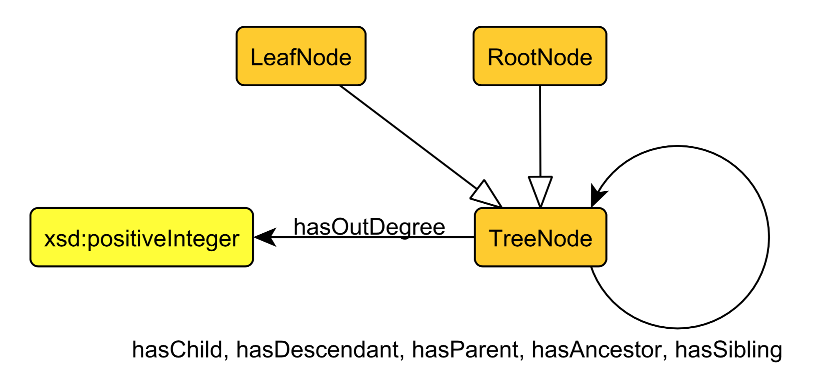
Axiomatisation

Slide 16
Axiomatisation: Definition
A tree contains exactly one root node, which has no incoming edges.

Slide 17
Axiomatisation: Definition
A tree contains exactly one root node, which has no incoming edges.

Slide 18
Axiomatisation: Definition
A tree contains exactly one root node, which has no incoming edges.
Every node which is not the root has exactly one incoming edge.

Slide 19
Axiomatisation: Definition
A tree contains exactly one root node, which has no incoming edges.
Every node which is not the root has exactly one incoming edge.

Slide 20
Axiomatisation: Definition
A tree contains exactly one root node, which has no incoming edges.
Every node which is not the root has exactly one incoming edge.
Every node can be reached from the root.

Slide 21
Axiomatisation: Definition
A tree contains exactly one root node, which has no incoming edges.
Every node which is not the root has exactly one incoming edge.
Every node can be reached from the root.

Slide 22
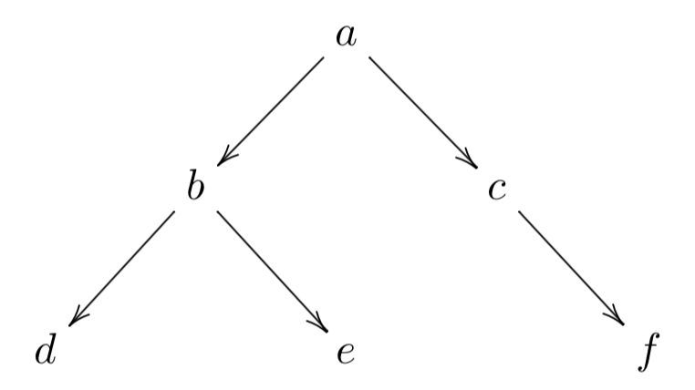
Axiomatisation: ABox Encoding

Slide 23
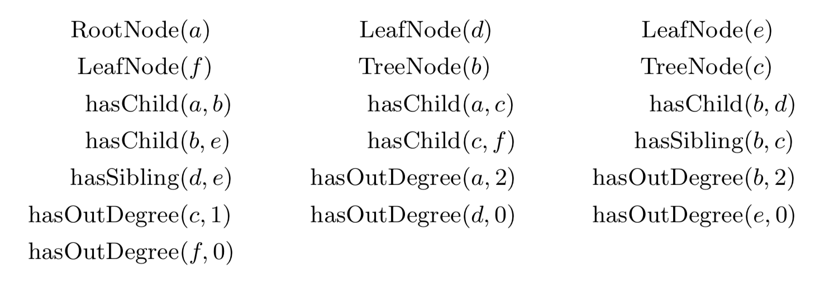
Axiomatisation: ABox Encoding

Slide 24
Axiomatisation

Slide 25
Axiomatisation

Slide 26
Axiomatisation

Slide 27
Axiomatisation

Slide 28
Axiomatisation: A Competency question
Given two nodes x and y, determine the latest common ancestor.

Slide 29
Axiomatisation: A Competency question
Given two nodes x and y, determine the latest common ancestor.

Slide 30
Axiomatisation: A Competency question
Given two nodes x and y, determine the latest common ancestor.

Slide 31
Axiomatisation: Trees with bounded arity
An n-ary bounded tree is a tree where every node has at most n children.

Slide 32
Axiomatisation: Trees with bounded arity
An n-ary bounded tree is a tree where every node has at most n children.
Special axiomatisation

Slide 33
Conclusions
Modeling trees is not possible with a FOL based formalism.
Nevertheless, we can capture many useful properties and solve competency questions using a design pattern.

Slide 34
Conclusions
Modeling trees is not possible with a FOL based formalism.
Nevertheless, we can capture many useful properties and solve competency questions using a design pattern.
Future work
Develop a ODP for (possibly acyclic) graphs.

Slide 36
On the Ontological Modeling of Trees
David Carral¹, Pascal Hitzler², Hillmar Lapp³, and Sebastian Rudolph¹
¹ TU Dresden, Germany
² DaSe Laboratory, Wright State University, OH, USA
³ Center for Genomic and Computational Biology, Duke University, Durham, NC, USA

